Slide 1
Bootcamp_Data Engineering Training
Prepared By,
Srimathi Chandrasekaran
01/06/2022

Slide 2
Chapter3: Spark Streaming & Lambda Architecture
Intro to Lambda Architecture => 31/05/2022
Spark streaming => 31/05/2022
Structured streaming => 01/06/2022
Apache Kafka => 01/06/2022
Structured streaming + Apache Kafka => 01/06/2022

Slide 3
Structured streaming
Structured Streaming is the Apache Spark API that lets you express computation on streaming data in the same way you express a batch computation on static data.
The Structured Streaming engine performs the computation incrementally and continuously updates the result as streaming data arrives.

Slide 4
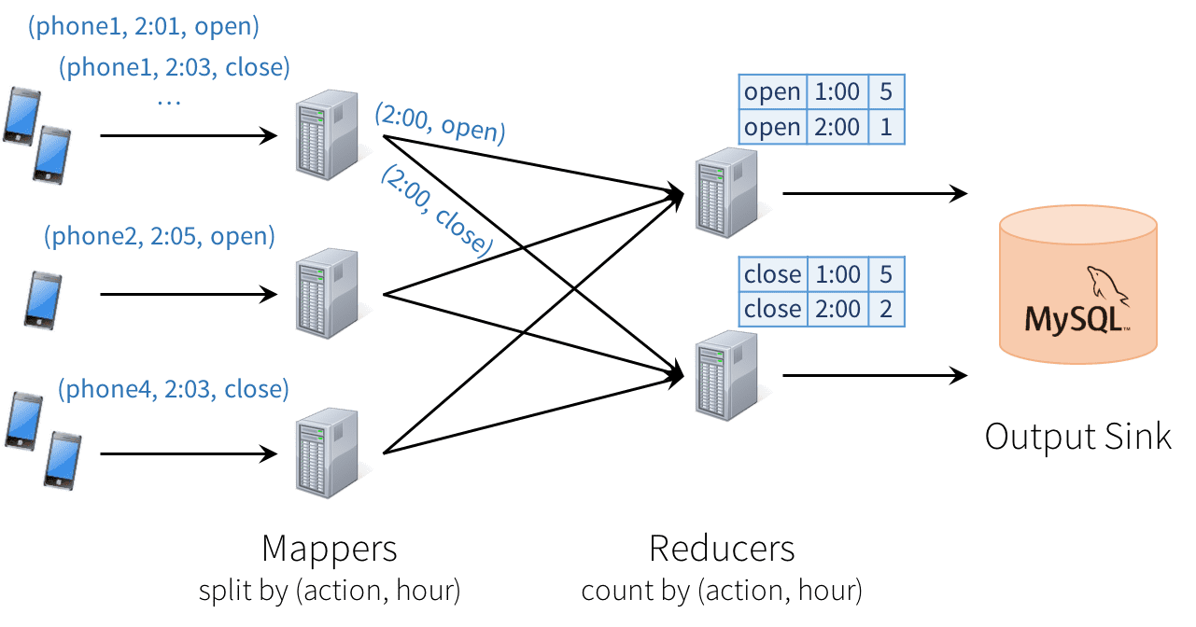
Distributed Streaming Engine:
Partition -> Hash/split in Mapper -> group count in Reducer -> Periodical update at MySQL

Slide 5
Consistency: This distributed design can cause records to be processed in one part of the system before they’re processed in another. In Structured Streaming, Output tables are always consistent with all the records in a prefix of the data.
Fault tolerance: What happens if one of the mappers or reducers fails? A reducer should not count an action in MySQL twice, but should somehow know how to request old data from the mappers when it comes up. Fault tolerance is handled holistically by Structured Streaming, including in interactions with output sinks. This was a major goal in supporting continuous applications.
Out-of-order data: In the real world, data from different sources can come out of order. We know that the job outputs counts grouped by action and time for a prefix of the stream. If we later receive more data, we might see a time field for an hour in the past, and we will simply update its respective row in MySQL. Structured Streaming also supports APIs for filtering out overly old data if the user wants.

Slide 6
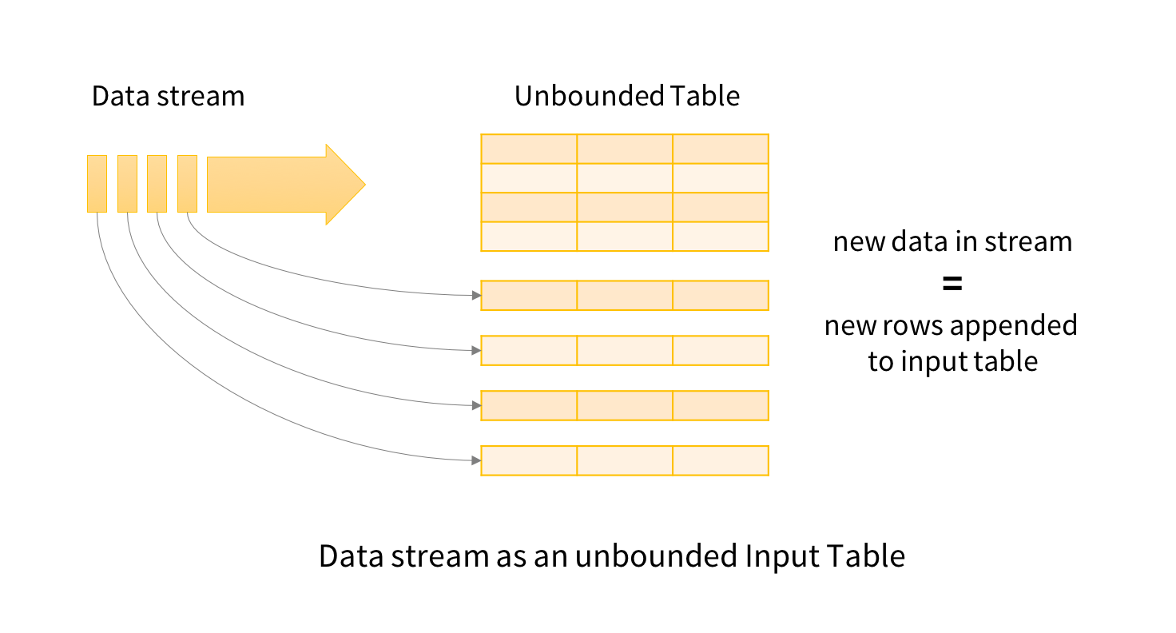
Model Details
Structured Streaming treats all the data arriving as an unbounded input table. Each new item in the stream is like a row appended to the input table. We won’t actually retain all the input, but our results will be equivalent to having all of it and running a batch job.
The developer then defines a query on this input table, as if it were a static table, to compute a final result table that will be written to an output sink. Spark automatically converts this batch-like query to a streaming execution plan. This is called incrementalization:
Spark figures out what state needs to be maintained to update the result each time a record arrives. Finally, developers specify triggers to control when to update the results. Each time a trigger fires, Spark checks for new data (new row in the input table), and incrementally updates the result.

Slide 7
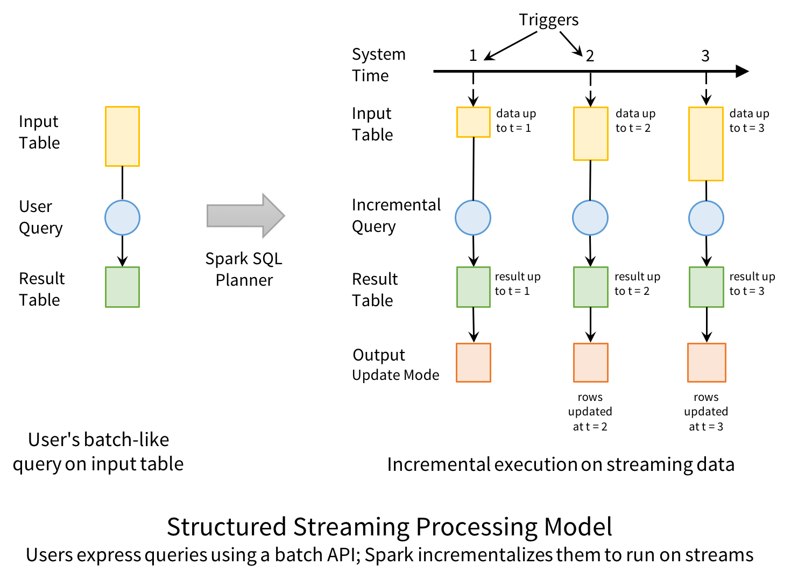
Structured Streaming provides three output modes:
Append: Only the new rows appended to the result table since the last trigger will be written to the external storage. This is applicable only on queries where existing rows in the result table cannot change (e.g. a map on an input stream).
Complete: The entire updated result table will be written to external storage.
Update: Only the rows that were updated in the result table since the last trigger will be changed in the external storage. This mode works for output sinks that can be updated in place, such as a MySQL table.

Slide 8
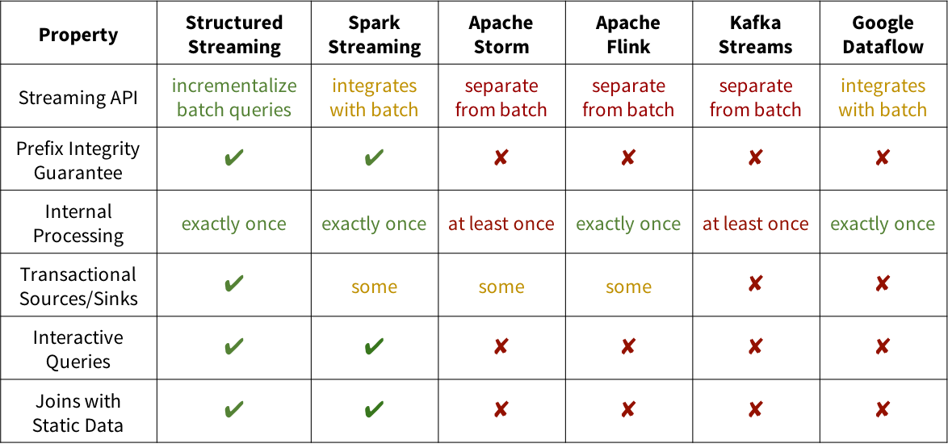
Comparison With Other Engines

Slide 9
Demo notebooks | Databricks on AWS
Batch/Interactive Processing
from pyspark.sql.types import *
inputPath = "/databricks-datasets/structured-streaming/events/"
# Since we know the data format already, let's define the schema to speed up processing (no need for Spark to infer schema)
jsonSchema = StructType([ StructField("time", TimestampType(), True), StructField("action", StringType(), True) ])
# Static DataFrame representing data in the JSON files
staticInputDF = (
spark
.read
.schema(jsonSchema)
.json(inputPath)
)
display(staticInputDF)

Slide 10
compute the number of "open" and "close" actions with one hour windows. To do this, we will group by the action column and 1 hour windows over the time column.
from pyspark.sql.functions import * # for window() function
staticCountsDF = (
staticInputDF
.groupBy(
staticInputDF.action,
window(staticInputDF.time, "1 hour"))
.count()
)
staticCountsDF.cache()
# Register the DataFrame as table 'static_counts'
staticCountsDF.createOrReplaceTempView("static_counts")

Slide 11
Stream Processing
from pyspark.sql.functions import *
# Similar to definition of staticInputDF above, just using `readStream` instead of `read`
streamingInputDF = (
spark
.readStream
.schema(jsonSchema) # Set the schema of the JSON data
.option("maxFilesPerTrigger", 1) # Treat a sequence of files as a stream by picking one file at a time
.json(inputPath) )
# Same query as staticInputDF
streamingCountsDF = (
streamingInputDF
.groupBy(
streamingInputDF.action,
window(streamingInputDF.time, "1 hour"))
.count() )
# Is this DF actually a streaming DF?
streamingCountsDF.isStreaming
Out[3]: True

Slide 12
set the complete set of 1 hour counts to be in a in-memory table
spark.conf.set("spark.sql.shuffle.partitions", "2") # keep the size of shuffles small
query = (
streamingCountsDF
.writeStream
.format("memory") # memory = store in-memory table
.queryName("counts") # counts = name of the in-memory table
.outputMode("complete") # complete = all the counts should be in the table
.start()
)

Slide 13
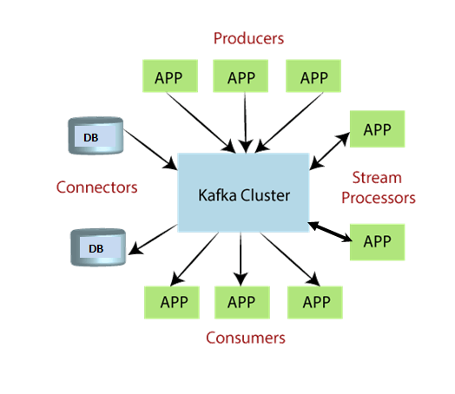
Apache Kafka
Apache Kafka is an open-source stream-processing software platform which is used to handle the real-time data storage. It works as a broker between two parties, i.e., a sender and a receiver. It can handle about trillions of data events in a day.
A messaging system is a simple exchange of messages between two or more persons, devices, etc. A publish-subscribe messaging system allows a sender to send/write the message and a receiver to read that message. In Apache Kafka, a sender is known as a producer who publishes messages, and a receiver is known as a consumer who consumes that message by subscribing it.

Slide 14
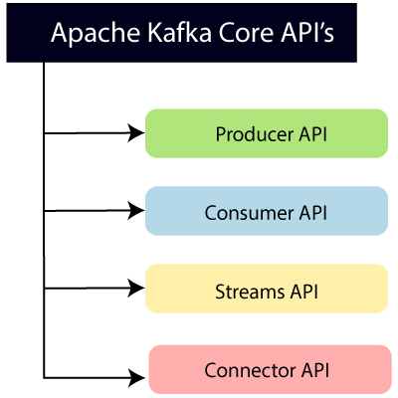
Apache Kafka Core API
Producer API: This API allows/permits an application to publish streams of records to one or more topics. (discussed in later section)
Consumer API: This API allows an application to subscribe one or more topics and process the stream of records produced to them.
Streams API: This API allows an application to effectively transform the input streams to the output streams. It permits an application to act as a stream processor which consumes an input stream from one or more topics, and produce an output stream to one or more output topics.
Connector API: This API executes the reusable producer and consumer APIs with the existing data systems or applications.

Slide 15
Why Apache Kafka
Apache Kafka is capable of handling millions of data or messages per second.
Apache Kafka works as a mediator between the source system and the target system. Thus, the source system (producer) data is sent to the Apache Kafka, where it decouples the data, and the target system (consumer) consumes the data from Kafka.
Apache Kafka is having extremely high performance, i.e., it has really low latency value less than 10ms which proves it as a well-versed software.
Apache Kafka has a resilient architecture which has resolved unusual complications in data sharing.
Organizations such as NETFLIX, UBER, Walmart, etc. and over thousands of such firms make use of Apache Kafka.
Apache Kafka is able to maintain the fault-tolerance. Fault-tolerance means that sometimes a consumer successfully consumes the message that was delivered by the producer. But, the consumer fails to process the message back due to backend database failure, or due to presence of a bug in the consumer code. In such a situation, the consumer is unable to consume the message again. Consequently, Apache Kafka has resolved the problem by reprocessing the data.
Learning Kafka is a good source of income. So, those who wish to raise their income in future in IT sector can learn.

Slide 16
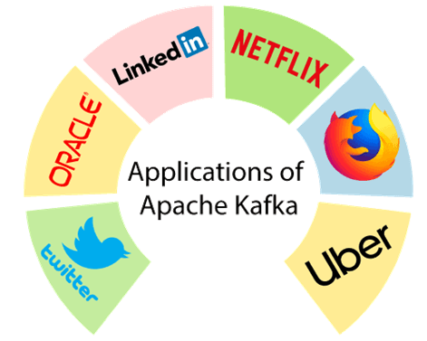
The demand for Apache Kafka is increasing at a tremendous speed. Many best enterprises today make use of Kafka to ease and grow their data pipelining requirements.
There are following applications of Apache Kafka:

Slide 17
Kafka Monitoring
1) Keeping tracks of utilized system resources
2) Keeps an eye on threads and JVM usage
3) Understands controller, broker, and replication statistics
4) Monitors the network as well as Topic Details
5) Manages faults and troubleshoot fastly
6) Provides data-rich reports on each performance metrics

Slide 18
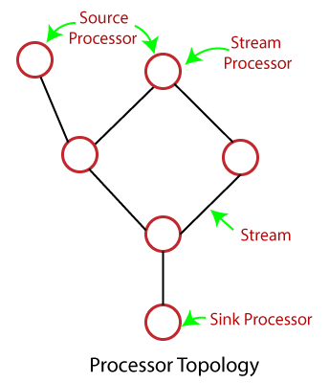
Stream Processing Topology
There are following two major processors present in the topology:
Source Processor: The type of stream processor which does not have any upstream processors. This processor consumes data from one or more topics and produces an input stream to its topologies.
Sink Processor: This is the type of stream processor which does not have downstream processors. The work of this processor is to send the received data from its upstream processors to the specified topic.

Slide 19
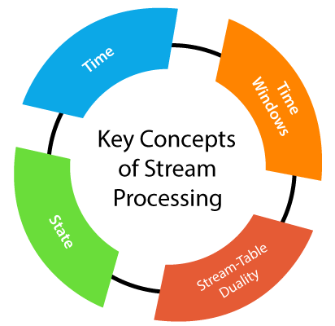
Kafka Streams provides two ways to represent the stream processing topology:
Kafka Streams DSL: It is built on top of Stream Processors API. Here, DSL extends for 'Domain Specific Language'. It is mostly recommended for beginners.
Processor API: This API is mostly used by the developers to define arbitrary stream processors, which processes one received record at a time. Further, it connects these processors with their state stores for composing processor topology. This composed topology represents a customized processing logic.

Slide 20
Spark Use Cases | Structured Streaming with Kafka | Use Case 1|Hands-On| Data Making |DM| DataMaking - Bing video
Spark Structured Streaming with Kafka using PySpark | Use Case 2 |Hands-On|Data Making|DM|DataMaking - Bing video

Slide 21



